Slide 1
K.RAMAKRISHNAN COLLEGE OF TECHNOLOGY , DEPT OF CSE – B.E – [ 2021- 2025 ] Batch
20CS7503 DESIGN PROJECT- 3
END SEMESTER PRESENTATION
Date & Session : 27.11.2024 & FN
Batch Number : 08
1

Slide 2
K-Means Clustering-Based Customer Segmentation
Name of the Candidates : RAHUL R
Register Number : 811721104081
Name of the Candidates : SAMSON JEBASEELAN C
Register Number : 811721104086
Name of the Candidates : SURAJ M
Register Number : 811721104108
Name of the Supervisor : Dr. A. Delphin Carolina Rani M.E.,Ph.D.,
with Designation
2
Notes:
2

Slide 3
Objectives of the Project
The aim and objective of the project is to book dining without any problem following
The primary objective of this project is to segment customers into distinct groups based on specific characteristics such as purchasing behavior, demographics, and other factors. Customer segmentation enables businesses to tailor marketing strategies, improve customer satisfaction, and boost overall profitability by targeting specific customer needs.
3

Slide 4
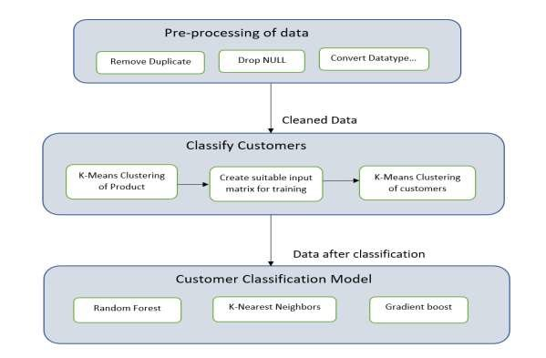
Existing System Architecture
4

Slide 5
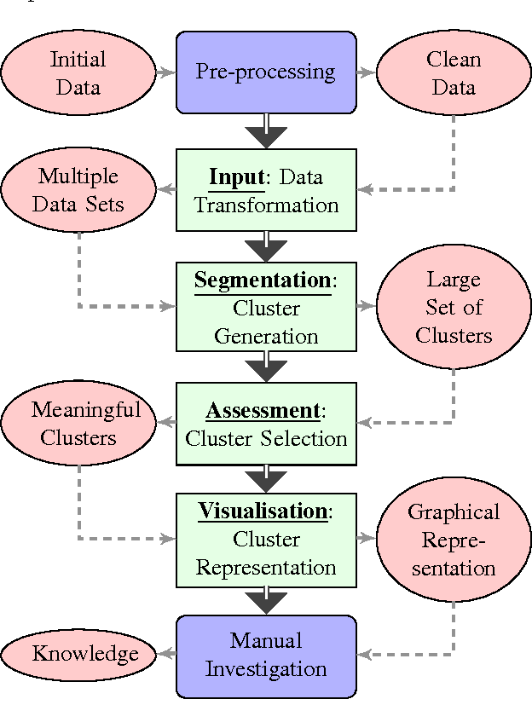
Proposed System Architecture
5

Slide 6
Modules in Project
Data Collection and Preprocessing:.
Exploratory Data Analysis (EDA).
Feature Selection and Transformation.
Clustering Algorithm Implementation.
6

Slide 7
Summary of Modules -1
Data Collection and Preprocessing:
Collect customer data, which may include demographic information, purchasing behavior, spending score, and income.
Clean the dataset by handling missing values, removing duplicates, and transforming categorical variables.
Standardize or normalize numerical features to improve the performance of clustering algorithms.
7

Slide 8
Summary of Module -2
Exploratory Data Analysis (EDA):
Perform exploratory data analysis to understand data distribution, identify patterns, and visualize relationships.
Use visualizations like histograms, box plots, and scatter plots to analyze customer characteristics and behaviors.
Check correlations between variables to decide which features will best represent each segment.
8

Slide 9
Summary of Module -3
Feature Selection and Transformation:
Select relevant features that contribute to customer segmentation, such as age, annual income, and spending score.
Scale or normalize features to ensure that all variables contribute equally to the clustering process.
9

Slide 10
Summary of Module -4
Clustering Algorithm Implementation:
Apply clustering algorithms such as K-Means, Hierarchical Clustering, or DBSCAN to group customers into segments.
Use techniques like the Elbow Method or Silhouette Score to determine the optimal number of clusters.
Assign each customer to a cluster, creating the basis for distinct customer segments.

Slide 11
Software & Hardware Requirements Specification
Software Requirements:
Programming Language: Python (version 3.x)
Libraries: pandas, numpy, sklearn, matplotlib, seaborn, scipy
IDE: Jupyter Notebook, PyCharm, or Visual Studio Code
Operating System: Windows, macOS, or Linux
Hardware Requirements:
Processor: Intel i5 or equivalent
RAM: 8GB or higher (for larger datasets)
Storage: 1GB of free space
11

Slide 12
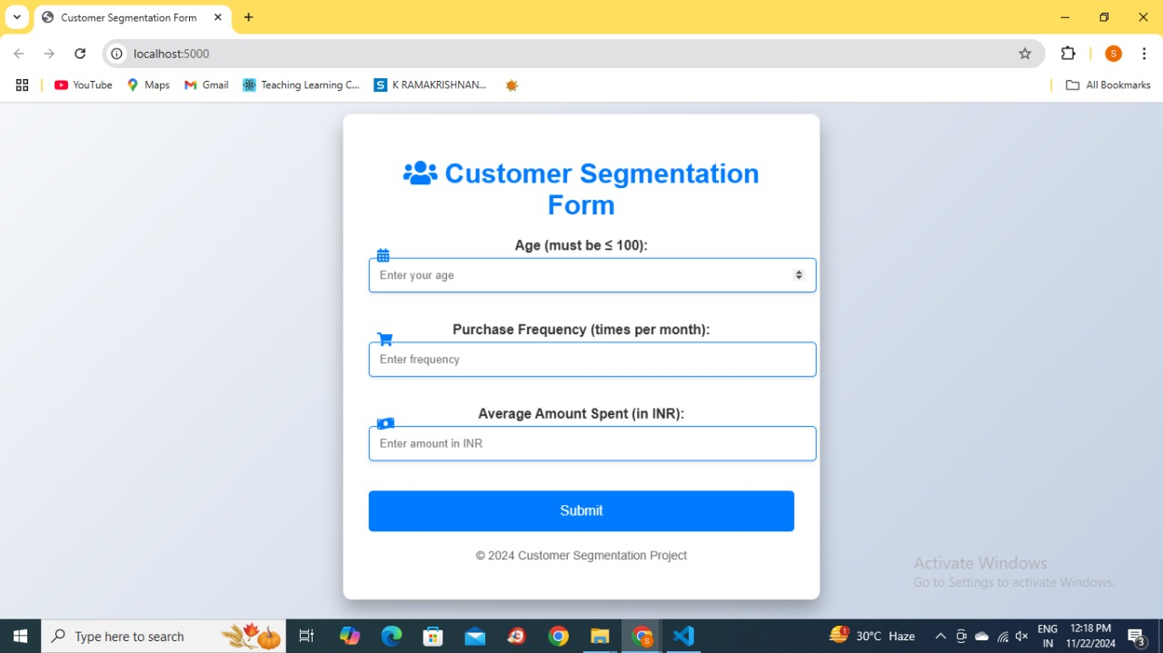
Implementation of Modules

Slide 13
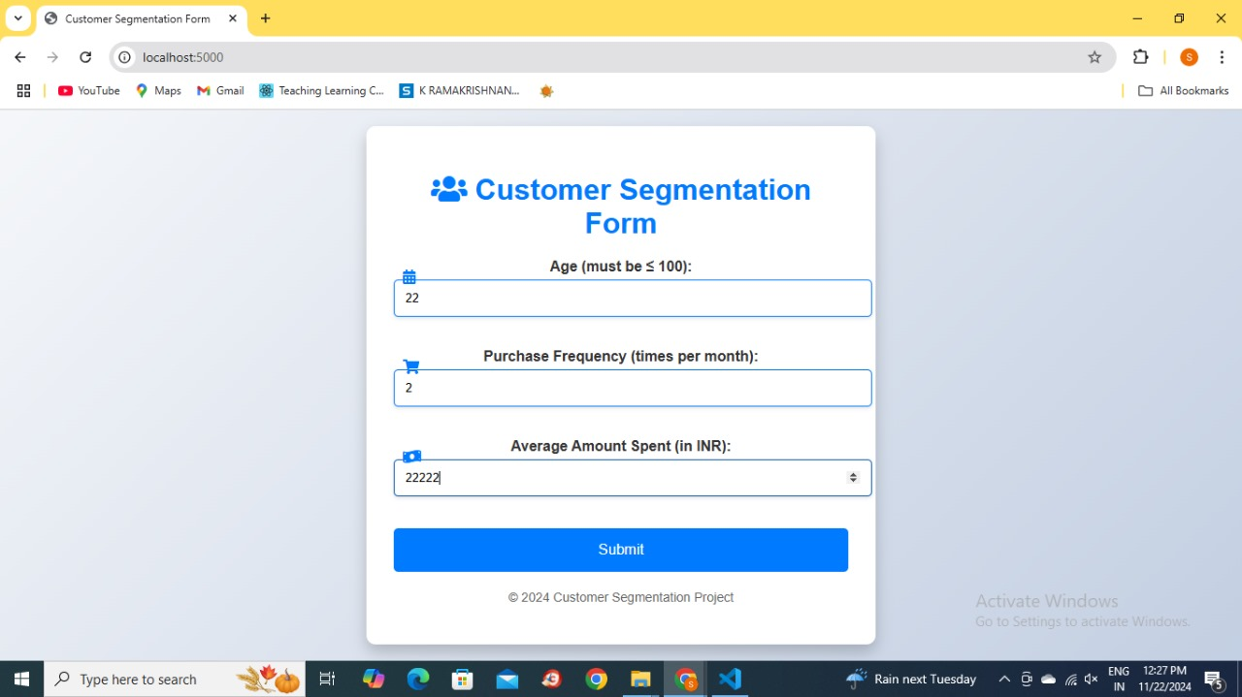
Implementation of Modules

Slide 14
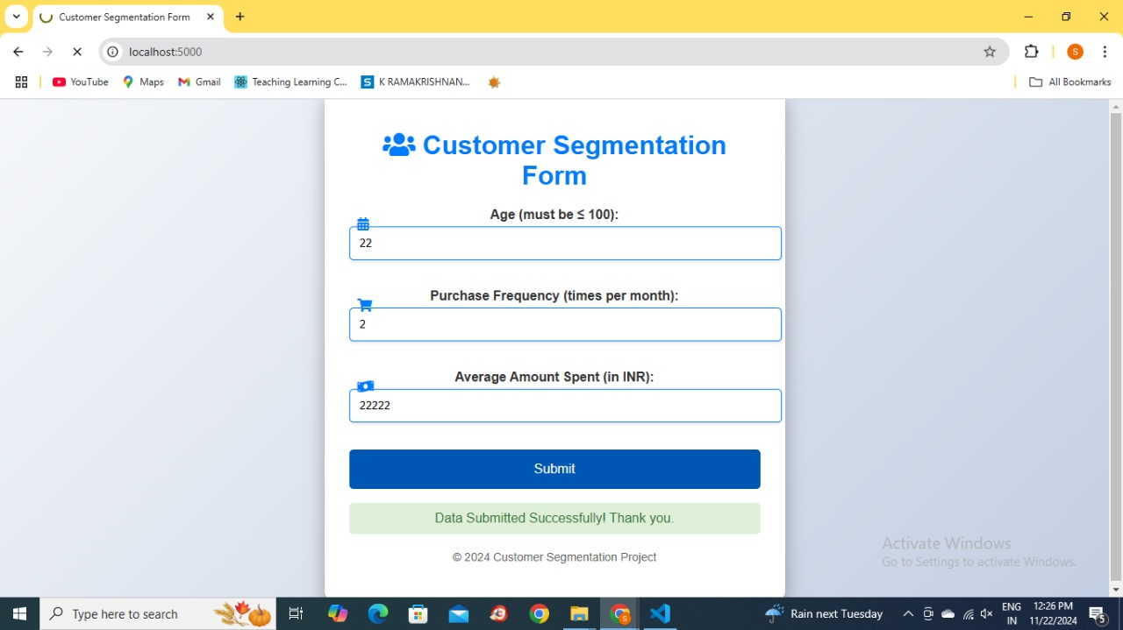
Implementation of Modules

Slide 15
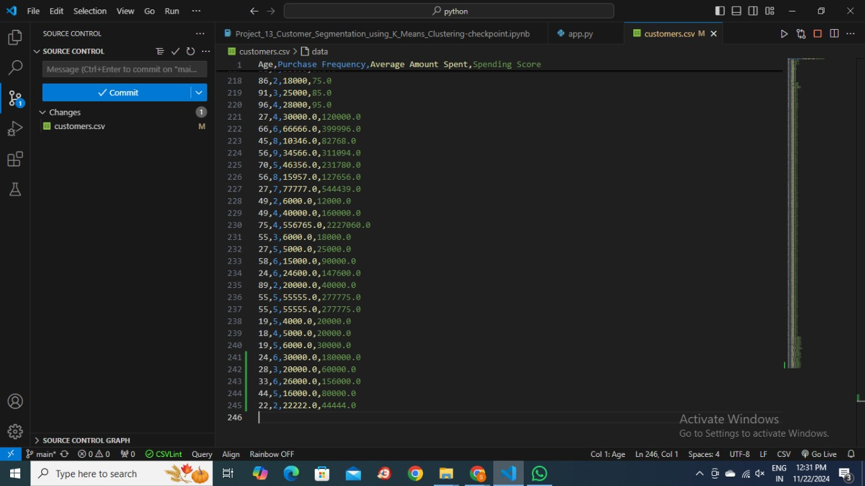
Implementation of Modules

Slide 16
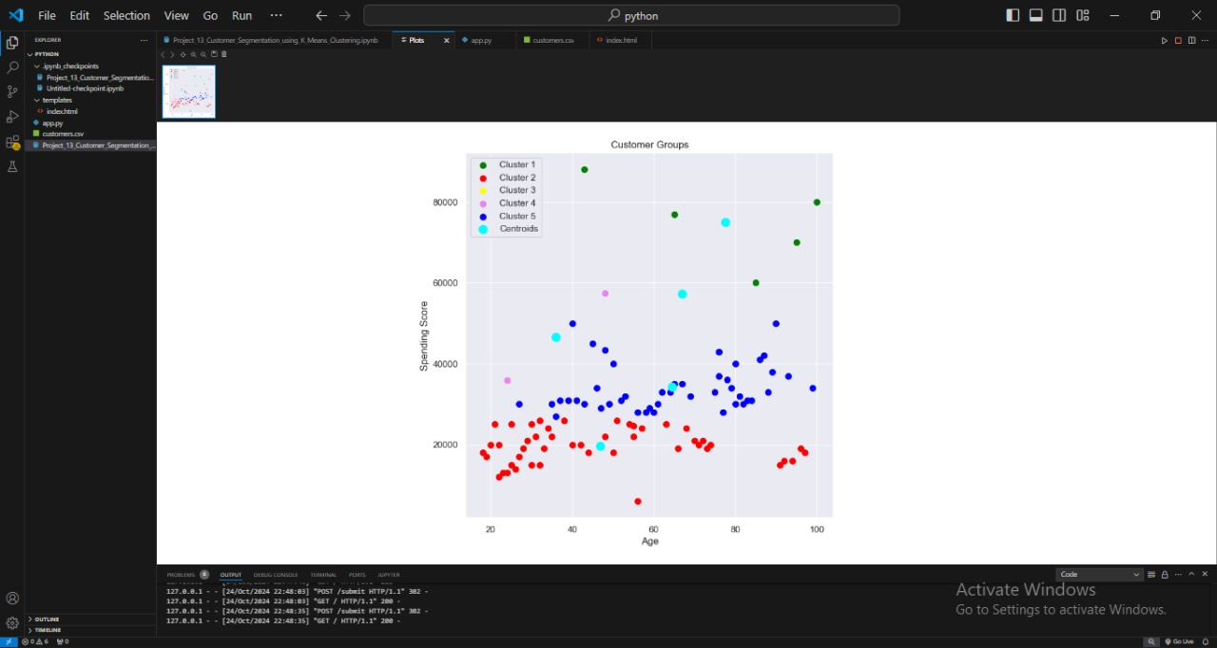
Implementation of Modules

Slide 17
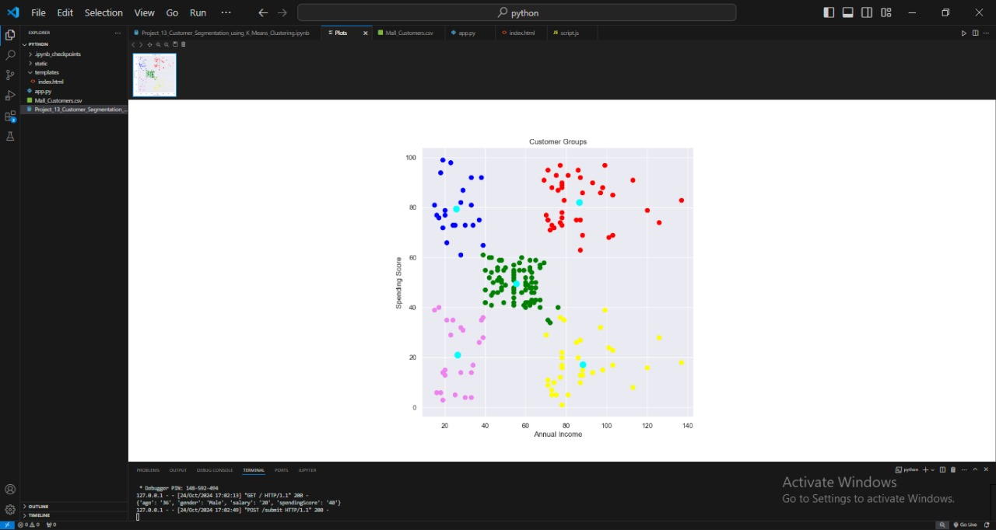
Implementation of Modules

Slide 18
FUTURE ENHANCEMENT
Advanced
Advanced Clustering Algorithms: Implement more complex clustering algorithms,
such as Gaussian Mixture Models or Density-Based Clustering (DBSCAN), to capture more nuanced customer behaviors.
Integration with Business Systems: Deploy the segmentation model to integrate with CRM or
marketing platforms for real-time targeting and personalization.
Incorporating Real-Time Data: Extend the segmentation model to use real-time data,
allowing dynamic updates to customer segments.

Slide 19
CONCLUSION
The customer segmentation project successfully identifies distinct groups within the customer base, providing valuable insights into customer behavior and preferences. These insights can guide businesses in personalizing marketing strategies, optimizing resource allocation, and enhancing customer satisfaction. By leveraging clustering techniques in Python, companies can make data-driven decisions that contribute to their overall growth and success.

Slide 20
Any Queries
Thank you
20

